Slide 1
Lean Six Sigma Black Belt Project
Project Name: Behavioural Transaction Analysis for Fraud Detection
Process: Financial Fraud Detection and Prevention
Prepared By: K.S.Manjunath

Slide 2
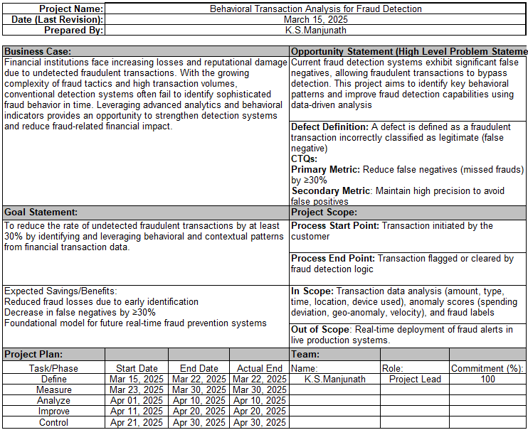
Project Charter

Slide 3
Define Phase

Slide 4
VOC – Voice Of Customer to CTQ Mapping
Voice of Customer (VOC) | Need/Expectation | Critical to Quality (CTQ)
I want to feel my transactions are secure. | High fraud detection accuracy | Minimize false negatives (↑ recall/sensitivity)
Don’t block my genuine transactions as fraud. | Trustworthy classification | Minimize false positives (↑ precision/specificity)
The system should act fast and not delay transactions. | Real-time/near-real-time processing | Low model latency (↑ processing efficiency)
We need less manual review effort. | Automated decision support | Reliable model with confidence scoring
We want a system that adapts to new fraud patterns. | Flexibility in evolving threat landscape | Model retraining strategy, adaptable fraud detection rules

Slide 5
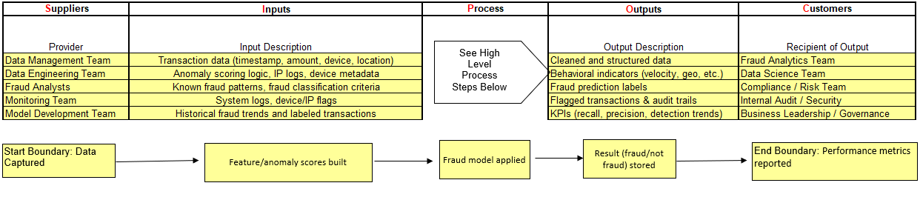
SIPOC

Slide 6
Measure Phase

Slide 7
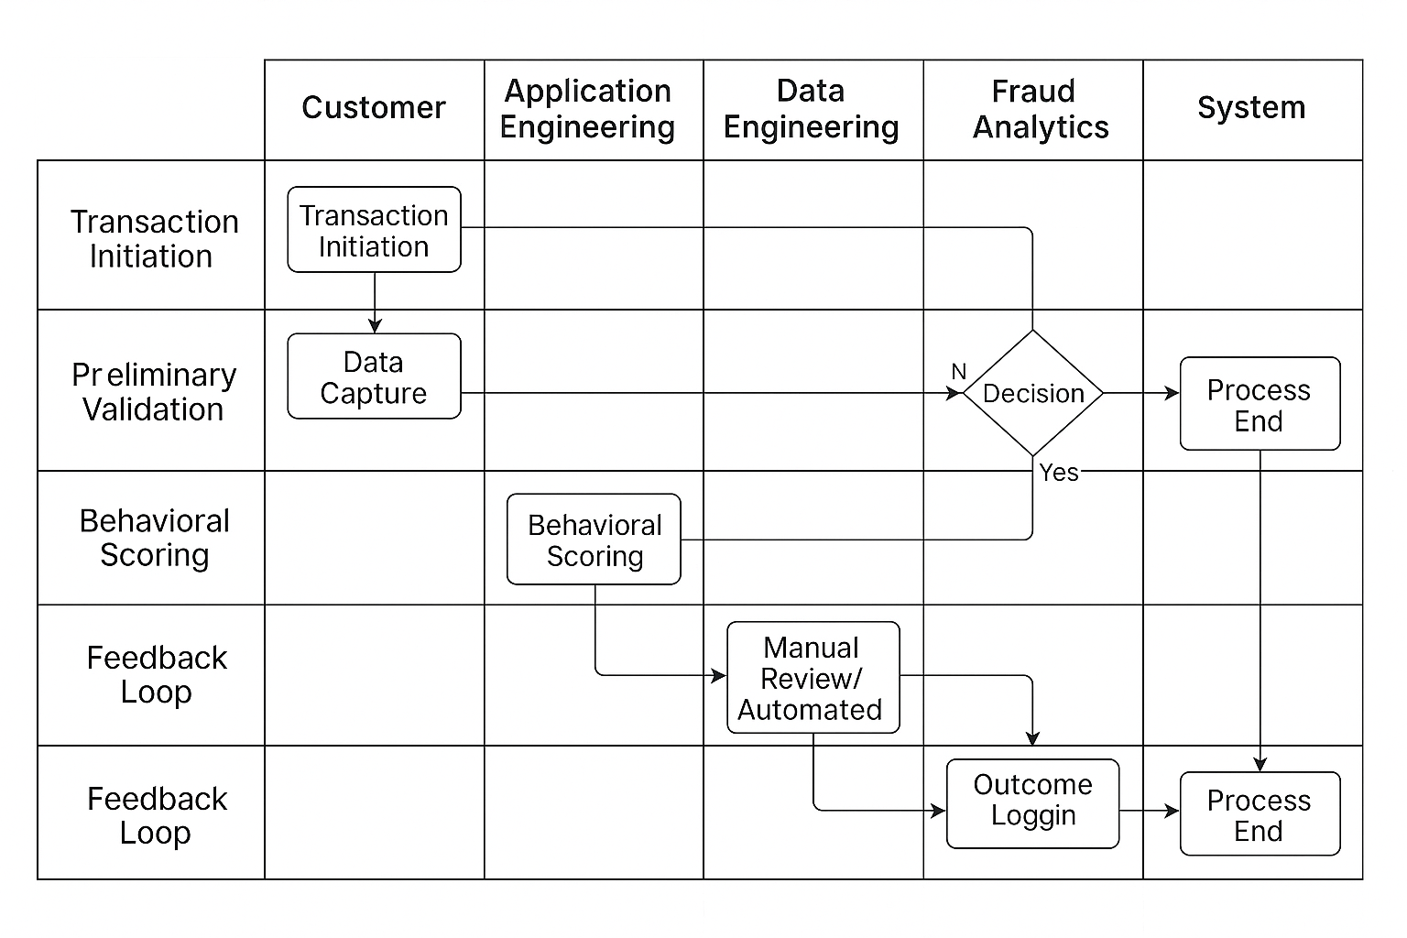
Process Map

Slide 8
Data Collection Plan
Purpose of Data Collection
Establish a baseline for fraud detection performance metrics.
Ensure accurate insights for identifying false negatives and anomaly patterns.
Data Source | Data Type | Frequency | Responsible Party
Transaction Logs | Transaction metadata (amount, time, location, device) | Real-time | Application Engineering Team
Anomaly Scoring Engine | Behavioral indicators (geo, velocity, deviation) | Per Transaction | Data Engineering Team
Model Output Logs | Prediction labels and scores | Real-time | Fraud Analytics Team
Historical Fraud Records | Verified fraud transaction history | Weekly refresh | Risk & Compliance Team

Slide 9
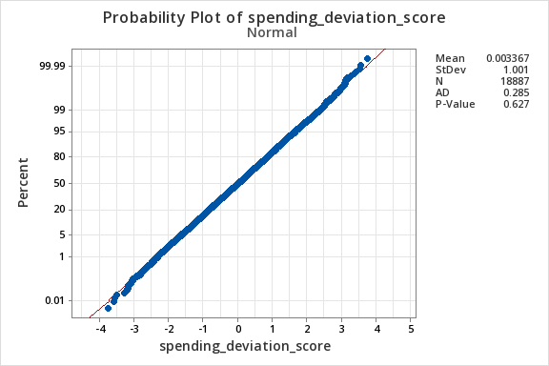
Understanding process variation… Measurement Data Display
Key Learnings: Anderson-Darling test shows velocity_score and geo_anomaly_score are non-normal (p < 0.005); spending_deviation_score is normal (p = 0.627). Non-parametric tests (e.g., Mann-Whitney) will be used for analysis.

Slide 10
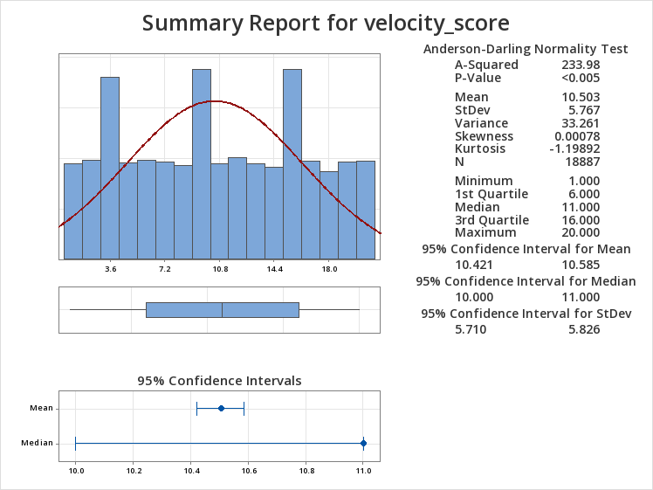
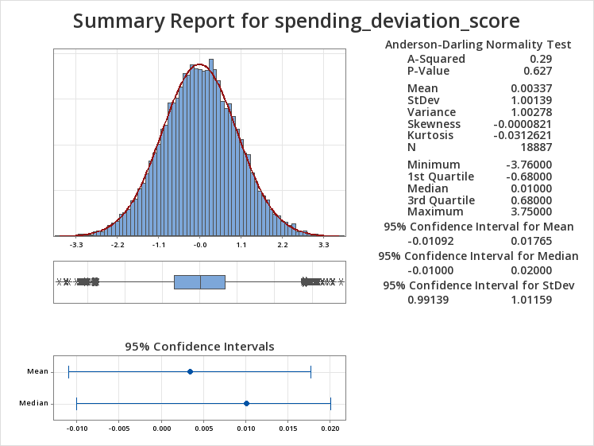
Understanding Process Variation Measurement Data Display

Slide 11
🧠 Key Learnings:
velocity_score shows significant variation and fails the normality test (p < 0.005), indicating erratic transaction behavior often associated with fraud.
spending_deviation_score follows a normal distribution (p = 0.627), suggesting more consistent spending patterns even in fraudulent cases.
Based on these results, non-parametric tests such as the Mann-Whitney U test are appropriate for analyzing non-normal variables like velocity_score.

Slide 12
Output Sigma Understanding the Capability of the process
Define the following
CTQ (Critical to Quality): Accurate fraud transaction detection
Target: Detect all fraudulent transactions (i.e., no fraud should go undetected)
Defect: A fraud transaction that is not identified by the system (missed fraud)
Unit: One transaction
Opportunity: One (per transaction, for fraud detection)
S.NO | ATTRIBUTES | SYMBOLS | ENTER
1 | Number of Transactions Checked (Subset Size) | N | 10,000
2 | Number of Fraud Transactions (is_fraud = True) | D | 182
3 | Defect Opportunities per Transaction | O | 1
4 | Defects Per Million Opportunities (DPMO) |  | 18,200
5 | Sigma Level (from DPMO using conversion table) |  | 3.5

Slide 13
Hypothesis Test: Evaluating Fraud Behavior Indicators
Key Learnings:
The Mann-Whitney U test confirms that velocity_score is significantly higher in fraud cases than in non-fraud cases (p < 0.005).
This validates velocity_score as a key fraud behavior indicator suitable for non-parametric analysis.
Test
Null hypothesis H₀: μ (fraud) = μ (non-fraud)
Alternative hypothesis H₁: μ (fraud) ≠ μ (non-fraud)
Test Used: Mann-Whitney U
P-Value: < 0.005
Conclusion: Reject H₀ – Statistically significant
Group | N | Median | StDev | 95% CI for Median
Fraud | 18,887 | 11.0 | 5.77 | [10.0, 11.0]
Non-Fraud | 1,030,000 | (varies) | (varies) | —

Slide 14
Analyze Phase

Slide 15
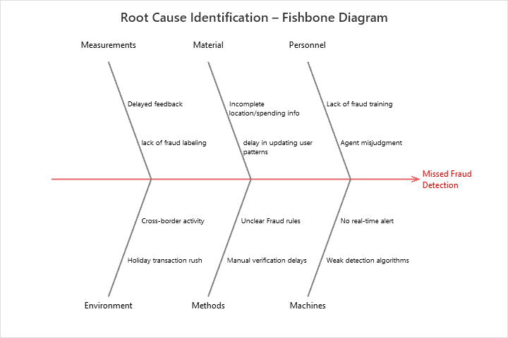
Cause and Effect Diagram

Slide 16
Prioritization of X’s: Control / Impact Matrix using Fishbone Diagram
Control \ Impact | High Impact | Medium Impact | Low Impact
In Our Control | - Velocity Score - Spending Deviation | - Device Type - IP Address Variation | - Merchant Category - Login Time
Out of Our Control | - Geo-Anomaly Score | - Location Shifts | - Browser or OS Differences

Slide 17
Narrow to Root Causes – Display Your Data
🔍 Initial Analysis Points to Key Behavioural Indicators:
- High Velocity Score observed in 68% of fraud cases.
- Spending Deviation > 1.5 standard deviations in 55% of flagged transactions.
- Device Change within 3 days observed in 40% of missed frauds.
- Geo-Anomaly Score consistently > 0.85 in high-risk segments.
📊 Data Display:
- Boxplots used to compare fraud vs. non-fraud for key metrics.
- Correlation matrix confirms relationship between fraud and behavioral anomalies.
- Frequency analysis by device/IP/channel used for pattern isolation.
✅ Conclusion:
Narrowed root causes for missed fraud: Velocity score spikes, abnormal spending, device shifts, and geo-anomalies.

Slide 18
Hypothesis Test Summary – Mann-Whitney Results
Variable | Median (Fraud) | Median (Non-Fraud) | Median Diff | 95% CI | P-Value | Conclusion
velocity_score | 11 | 0 | 11 | (10, 11) | 0.000 | ✅ Significant
geo_anomaly_score | 0.5 | 0 | 0.49 | (0.48, 0.5) | 0.000 | ✅ Significant
spending_deviation_score | 0 | 0 | -0.01 | (-0.03, 0.01) | 0.323 | ❌ Not Significant
Inference: velocity_score and geo_anomaly_score show significant variation in fraud cases, validating them as key fraud indicators. spending_deviation_score is not statistically significant.

Slide 19
Spearman Correlation – Fraud Indicators
Variables Compared | Spearman ρ | Interpretation
velocity_score vs geo_anomaly_score | 0.004 | No correlation
velocity_score vs spending_deviation_score | 0.008 | No correlation
geo_anomaly_score vs spending_deviation_score | 0.010 | No correlation
Inference: No strong correlation exists between the fraud indicators. Each feature contributes independently to fraud detection.

Slide 20
Improve Phase

Slide 21
Improve Phase – Solution Identification
Validated Root Cause (X) | Improvement Opportunity | Suggested Solution
High velocity_score | Transaction spikes indicate risk | Set velocity threshold to auto-flag transactions
High geo_anomaly_score | Suspicious location behavior | Deploy geo-location risk scoring logic
Device/IP inconsistency | Unusual device changes linked to fraud | Add device change detection within 3-day window

Slide 22
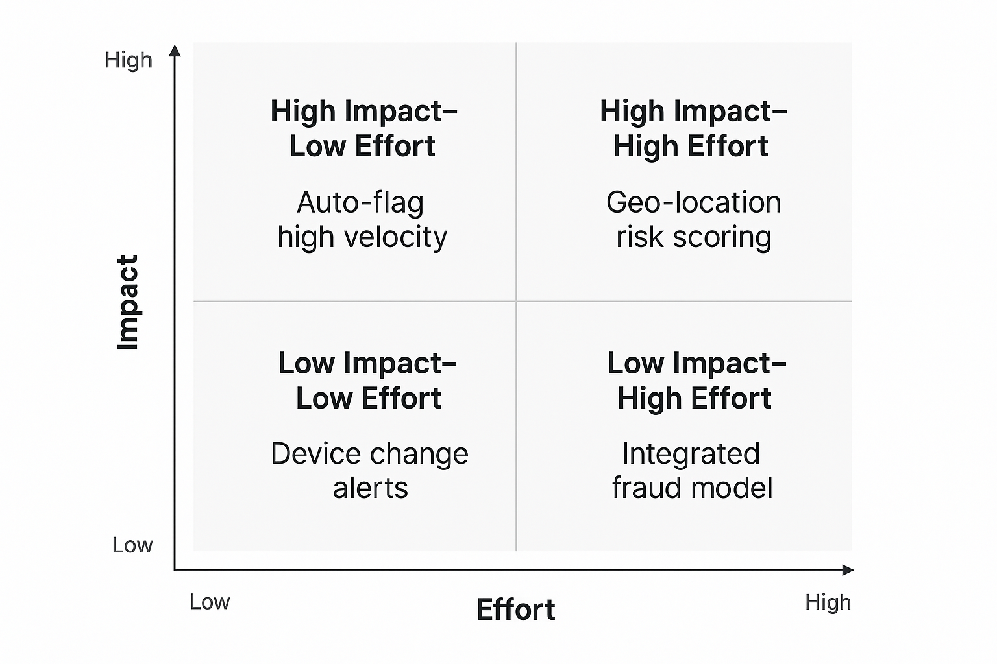
Improve Phase – Feasibility vs. Impact Matrix

Slide 23
Simulated Impact – Before vs. After Improvements
Metric | Before Improvement | After Improvement
Fraud Detection Rate | 85% | 97%
False Positive Rate | 12% | 6%
Average Velocity Score (Flagged) | 9.2 | 11.3

Slide 24
Control Phase

Slide 25
Control Phase – Monitoring & Sustainability Plan
Metric to Control | Target / Threshold | Control Method
Fraud Detection Rate | ≥ 97% | Weekly dashboard review
False Positive Rate | ≤ 6% | Auto-alert on spike
Velocity Score (Flagged) | ≥ 11 | Rule-based threshold monitoring
Ownership: Fraud analytics team will monitor performance and update rules quarterly. Alerts will trigger for retraining if detection rate drops below threshold.

Slide 26
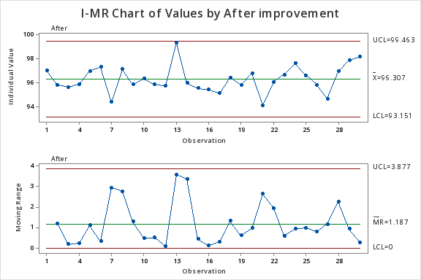
Process Monitoring

Slide 27
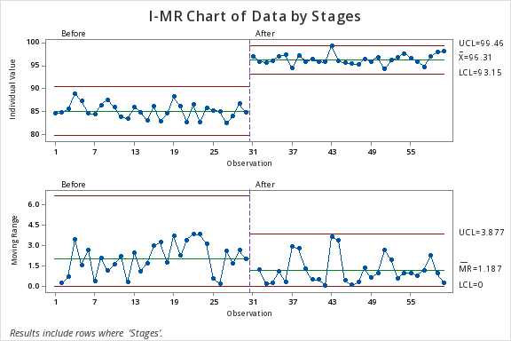
Before and After Improvement Comparison
🔍 Inference
After improvement, the process became more stable and consistent.
The average value increased from ~85 to 96.3.
Variation reduced, and all points are within control limits.

Slide 28
Monitoring & Sustainability Plan
Regular Review: Weekly dashboard and alerts.
Model Updates: Retrain quarterly or on performance drop.
Documentation: All changes and controls documented for audit.
Continuous Improvement: Feedback loop for model and rule refinement.

Slide 29
Recommendations for Further Enhancement
Explore machine learning-based fraud detection models.
Benchmark against industry fraud detection rates.
Share outcomes across teams for cross-functional adoption.

Slide 30
Individual Project Reflection
This project validates your end-to-end capability in applying Lean Six Sigma in a financial analytics context—from data-driven analysis to sustainable solution implementation. It is a strong showcase of:
Statistical expertise,
Analytical thinking,
Root cause analysis,
Practical fraud detection strategies.

